Slide 1

Consumer Satisfaction Analysis
Insights for Strategic Decision-Making ALY 6010:Final Project By: Shastika Bhandari

Slide 2
Introduction
Objective: Understand and predict factors influencing consumer satisfaction.
Data: Demographics, product categories, purchasing patterns, and satisfaction scores.
Approach: Data exploration, statistical analysis, and predictive modeling.

Slide 3
Dataset Overview
Consumer Demographics: Age, Income, Gender.
Product Categories: Electronics, Fashion, etc.
Satisfaction Scores: Average rating of 3.8, indicating room for improvement.

Slide 4
Key Findings - Demographics
Age: Majority are aged 20–40.
Income: Most consumers have modest income; a few have high income.
Gender: Balanced representation of male and female consumers.

Slide 5
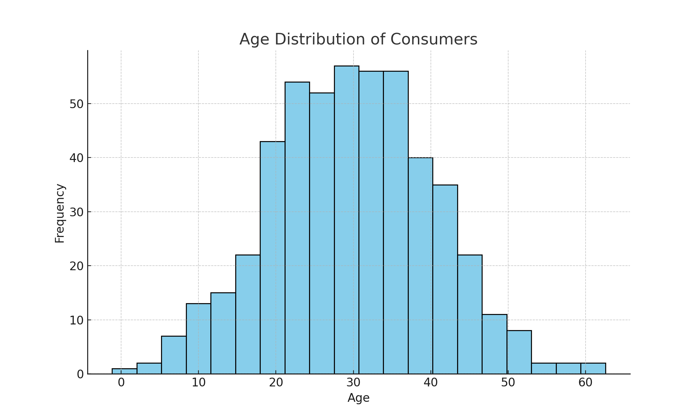
Demographics: Age Distribution

Slide 6
Key Findings - Satisfaction & Product Categories
Satisfaction Scores: Older consumers are more content.
Product Categories: Electronics consistently scored high, while fashion was variable.

Slide 7
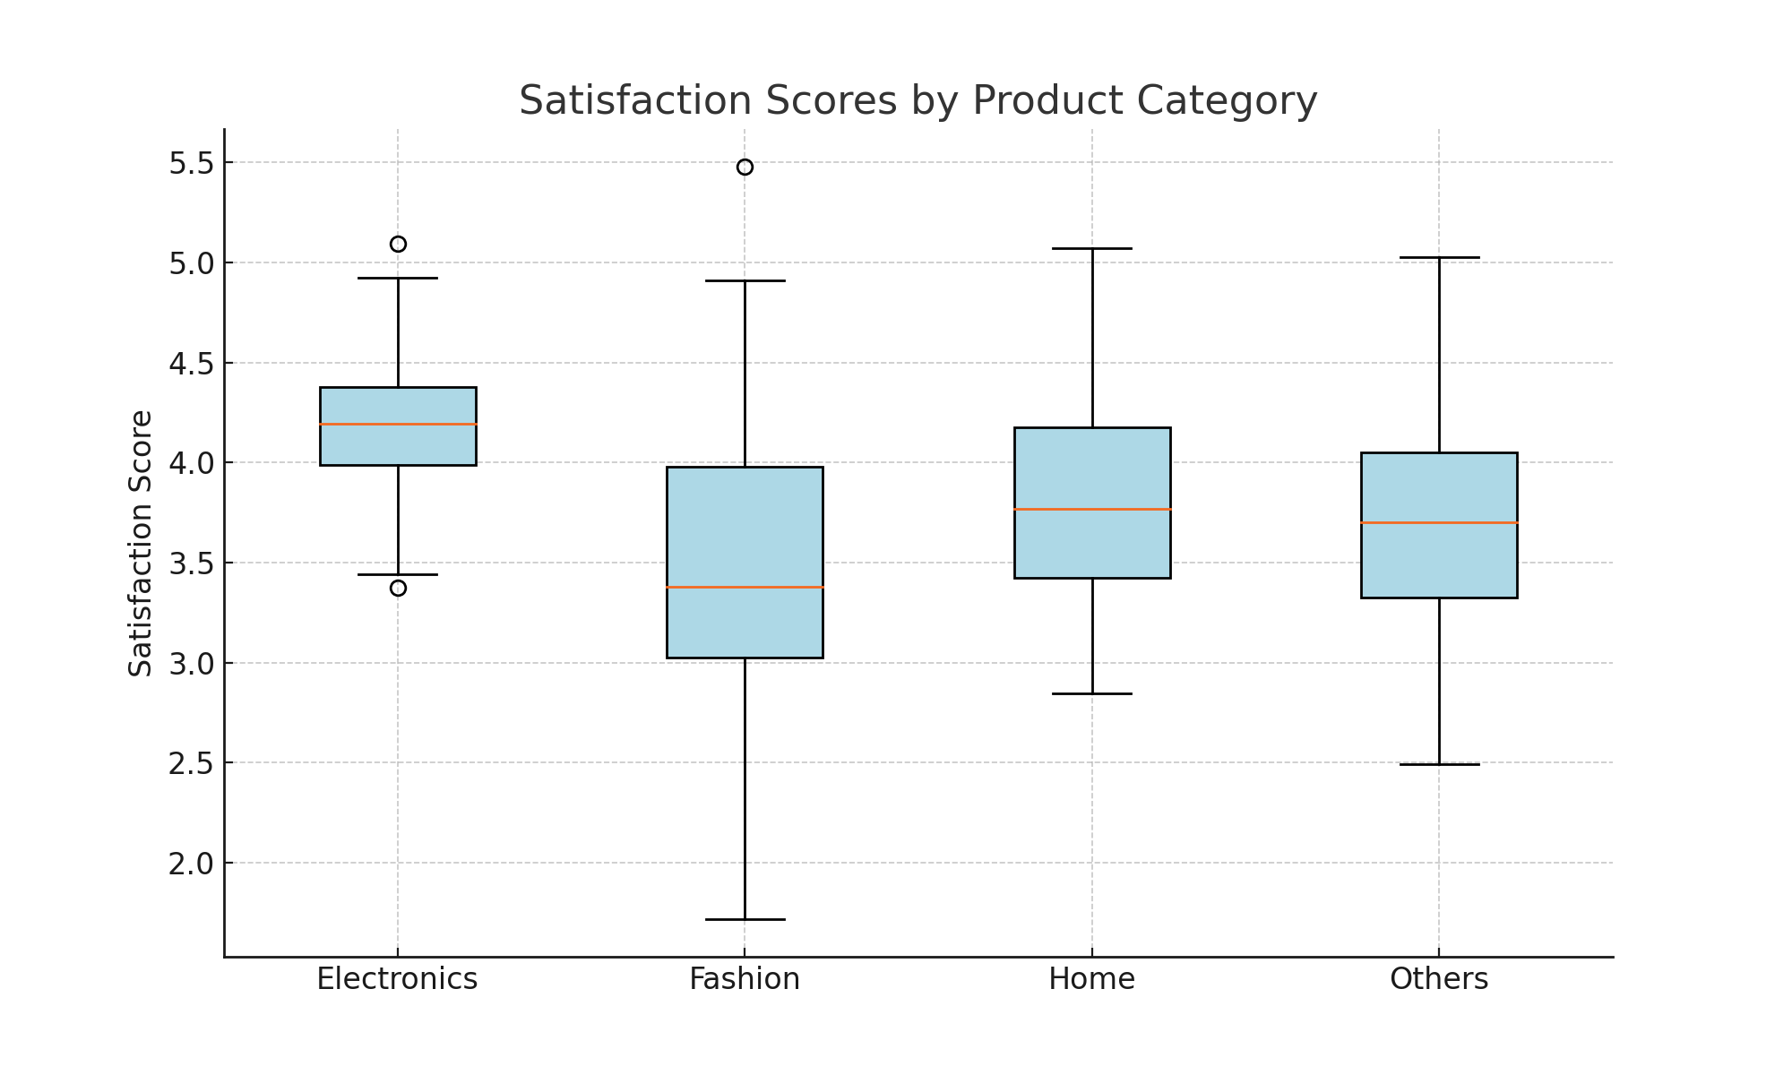
Product Categories: Satisfaction Scores

Slide 8
Statistical Insights
Age vs Satisfaction: Moderate positive correlation (r=0.42).
Product Categories: Significant differences (ANOVA, p<0.01).
Income: Explains 28% of satisfaction variance.

Slide 9
Predictive Modeling - Key Results
Model explained 46% of satisfaction variability (R² = 0.46).
Top Predictors: Age, Income, and Electronics category.
Implication: Wealthier, older consumers are likelier to be satisfied.

Slide 10
Strategic Implications
Focus marketing efforts on older, wealthier demographics.
Enhance product offerings in the electronics category.
Refine fashion product strategies to improve satisfaction.

Slide 11
Conclusion
Data-driven insights illuminate consumer preferences.
Actionable recommendations empower targeted strategies.
Future work: Explore additional predictors like purchase frequency.

